Slide 1
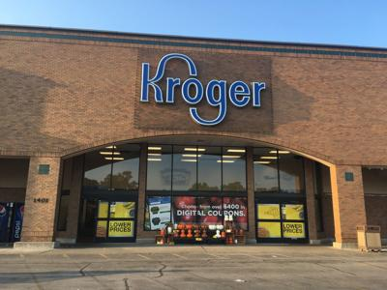
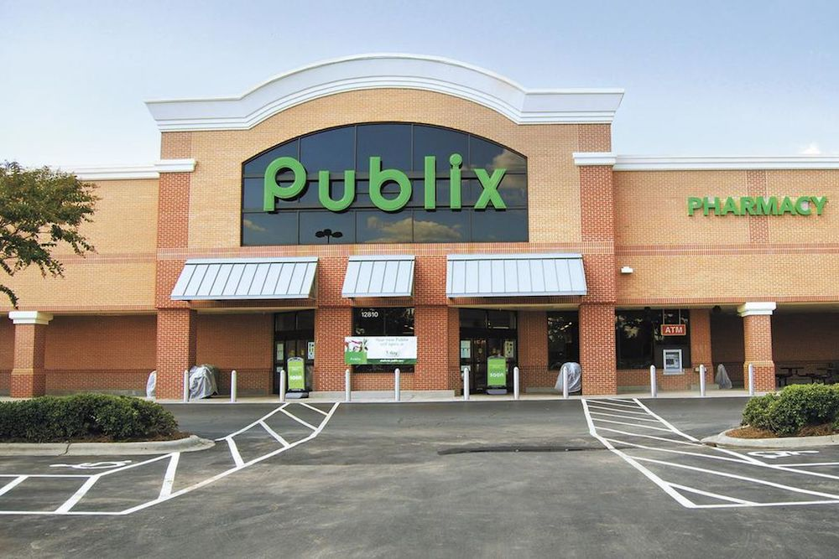

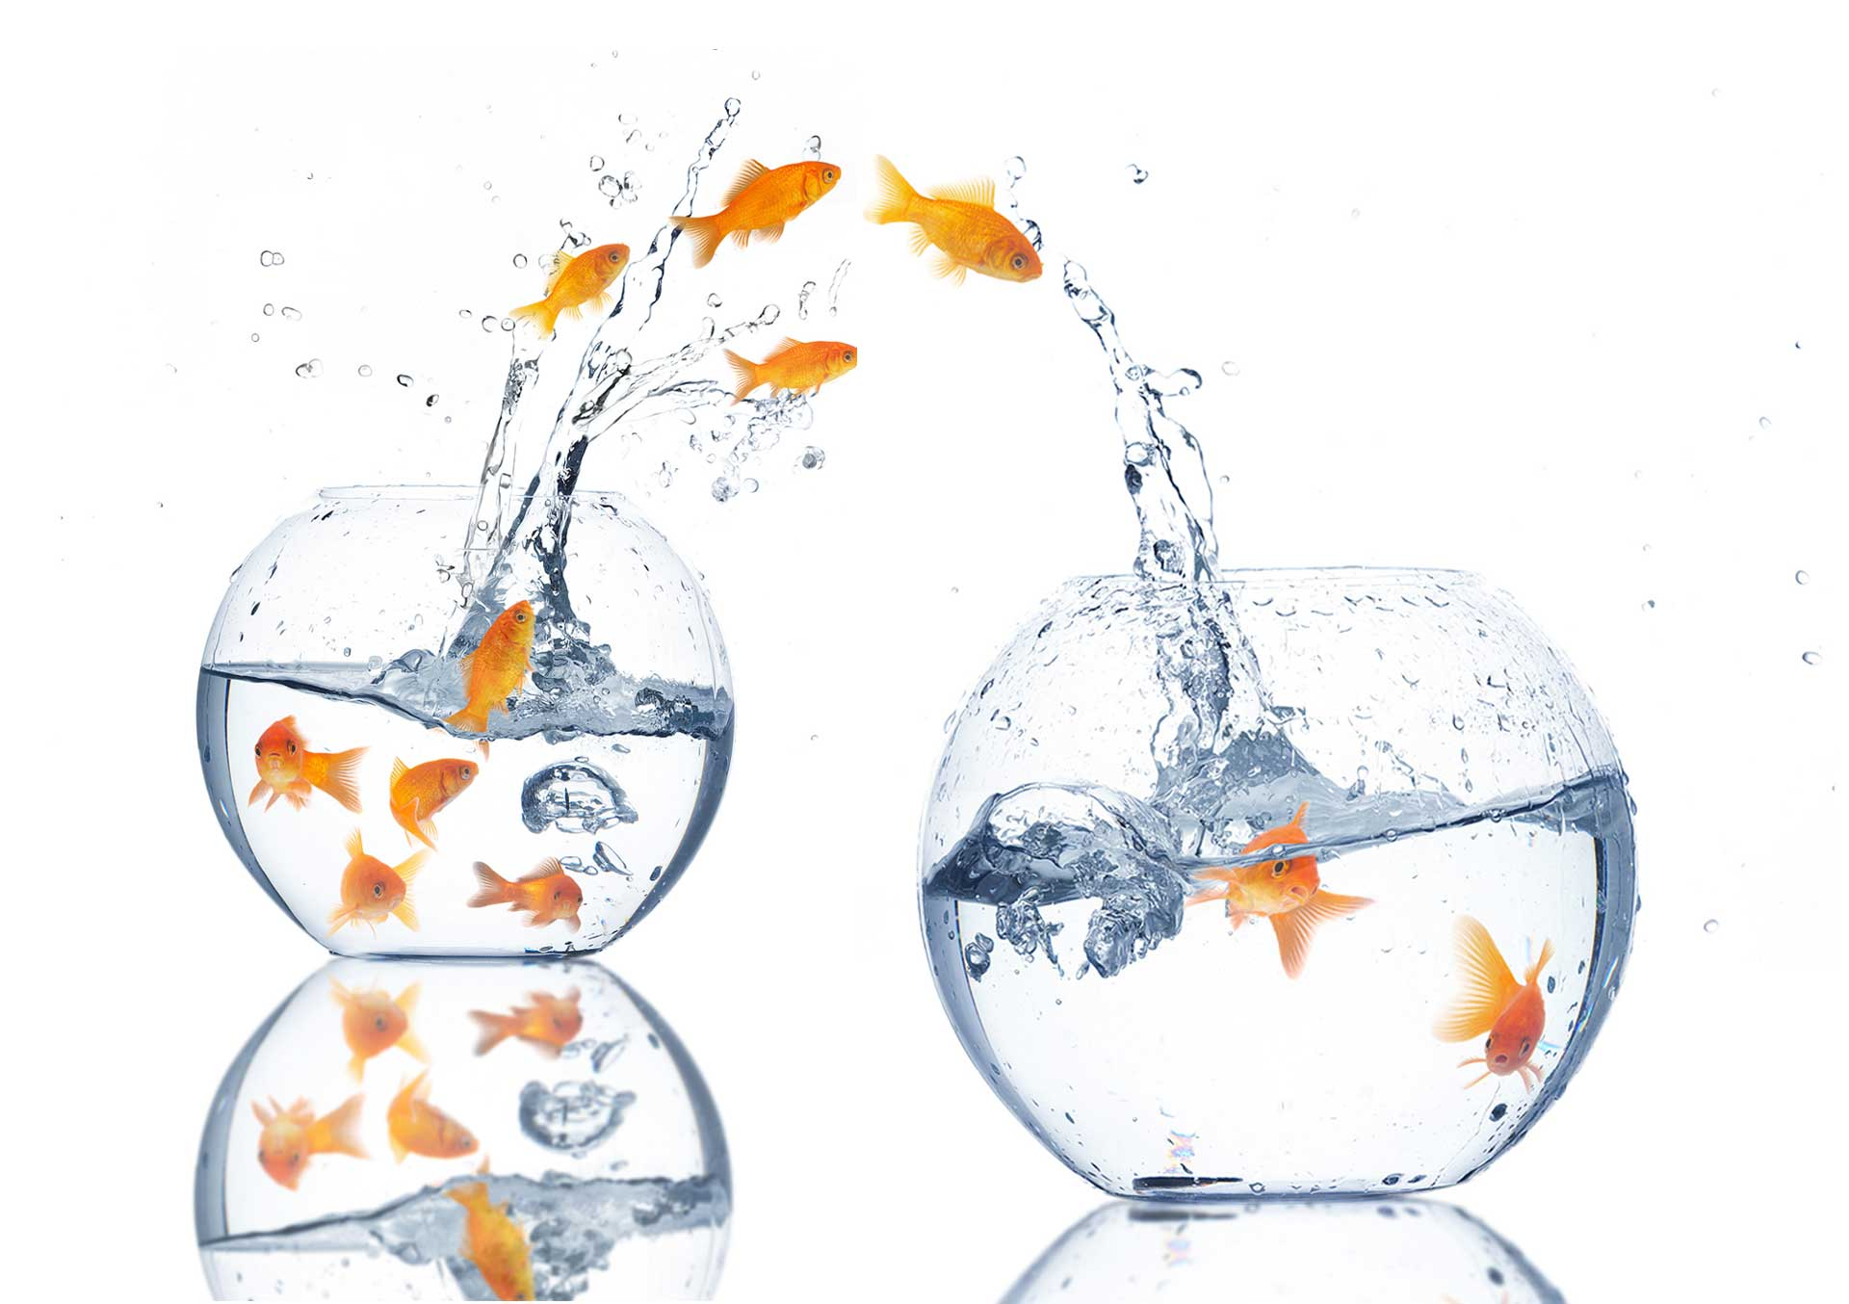

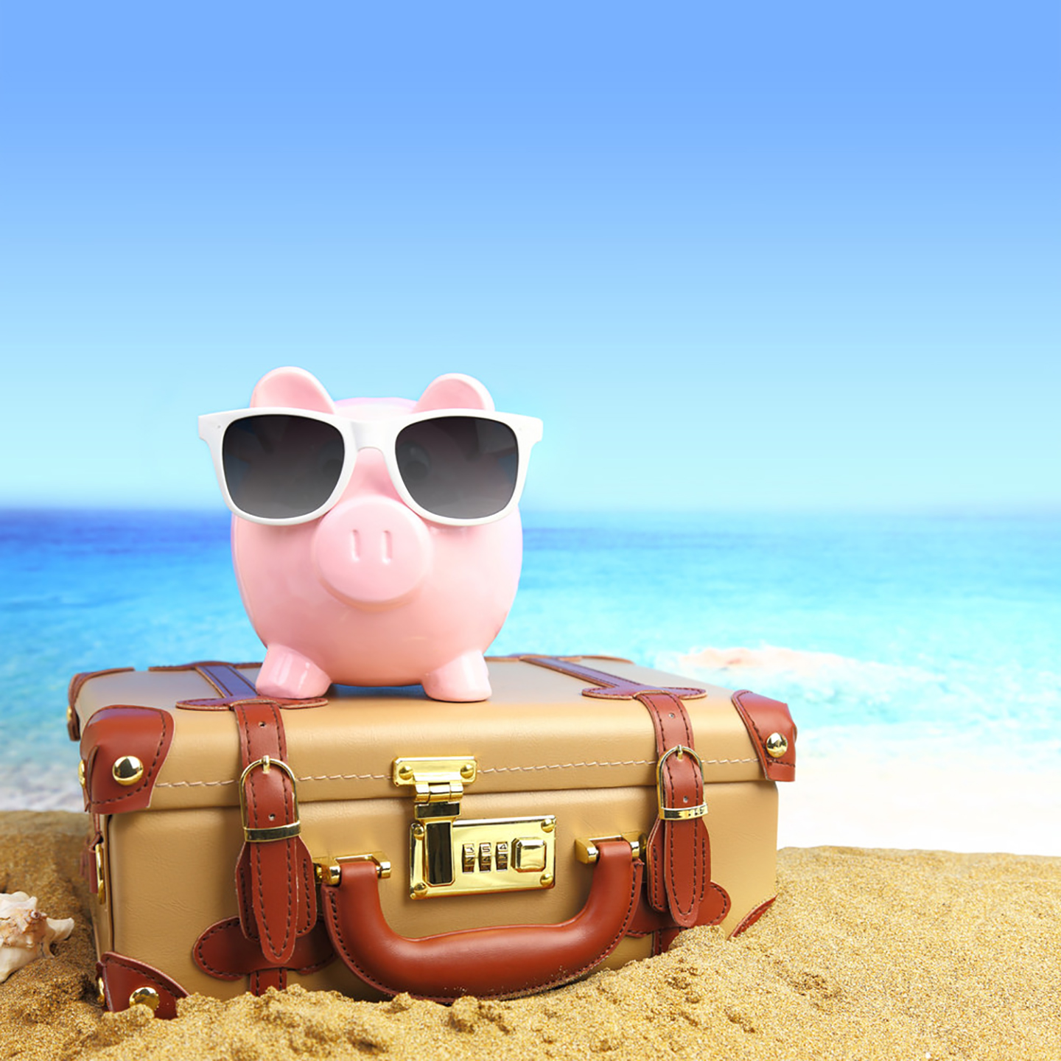



KRISTIN
ALVIN
Travel
Supermarkets
Science
Games
CHUN WAI
WEI CHIAT

Slide 2


Differentiating comments online via Natural Language Processing (NLP)

Slide 3
OR
1. “tire got damn replenish scan”
2. “peopl realli back car coconut mall mario kart”
3. “boar head pepperoni counter suppos unrefriger”
4. “kroger renov”
5. “got riot shield”

Slide 4
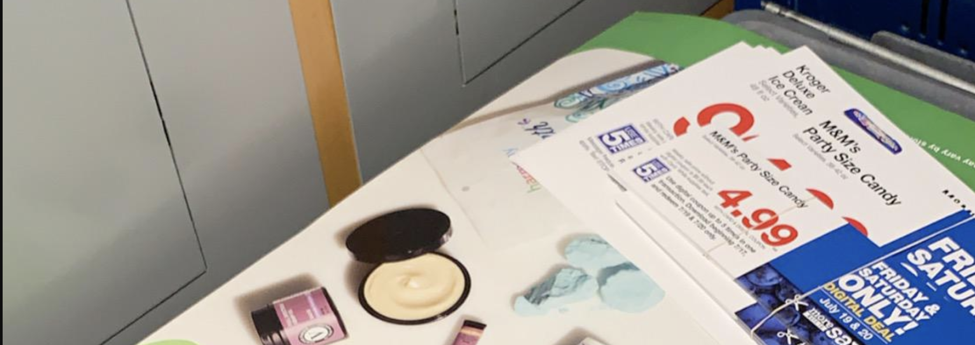
What about this?
“CBD is coming”

Slide 5
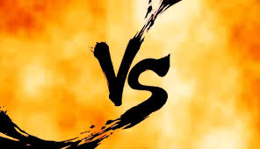


Slide 6

Wow VS Overwatch
Games from the same publisher, Blizzard entertainment.
Two different genres:
Fantasy Role-Playing game
Shooting game.
The top word “sigma” counts to 350 from the Overwatch posts.
The runner ups are the game titles Wow and Overwatch 75~87.
Other top words are not very Wow/Overwatch specific.

Slide 7
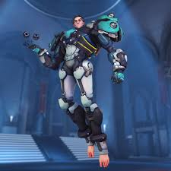
Wow vs Overwatch
A new character, Sigma was announced recently.
A game changer designed to change the pace of the game.
People are talking about his bare feet!

Slide 8
Wow vs Overwatch
The titles of the games are generally most mentioned unless there is a new development for the game.
The model accuracy was about 85%.
Posts that are incorrectly classified have nothing specific about the games.

Slide 9
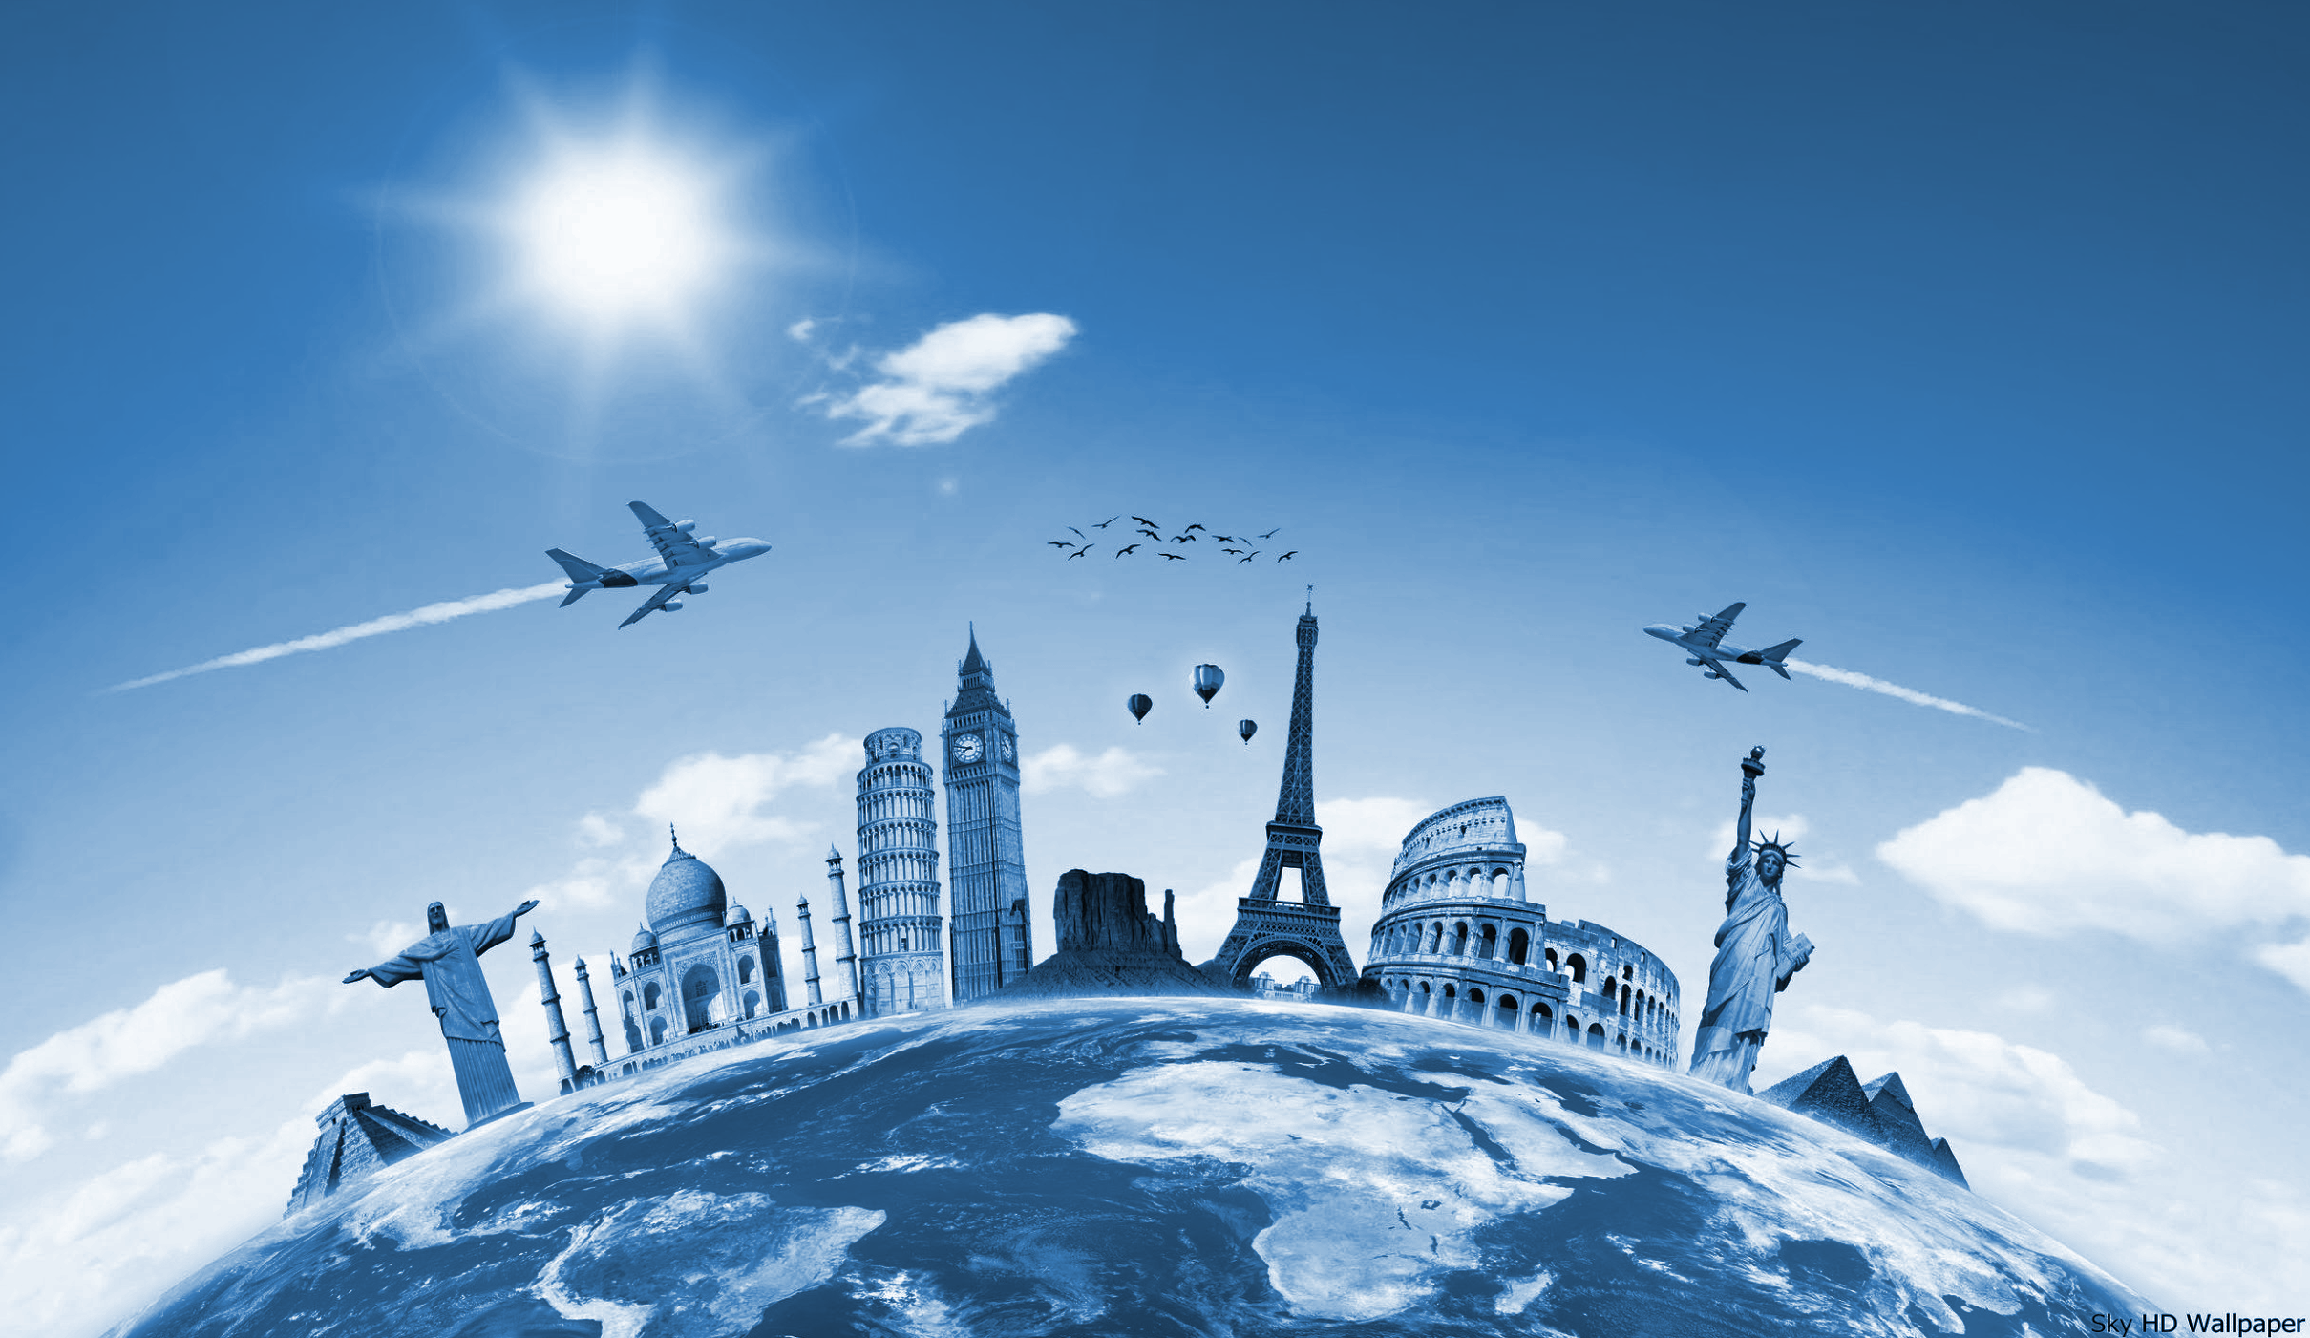
IWantOUT
-Immigration
Shoestring
-Budget Travel

Slide 10
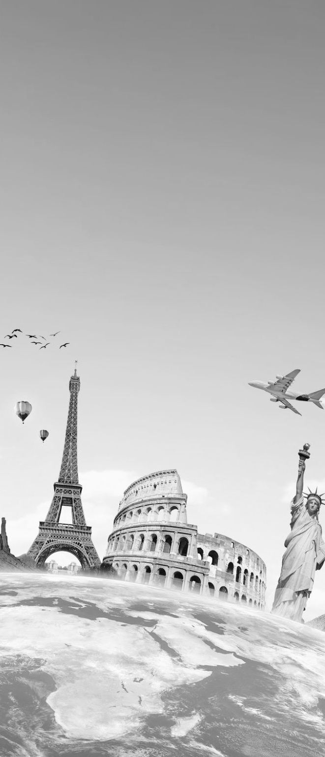
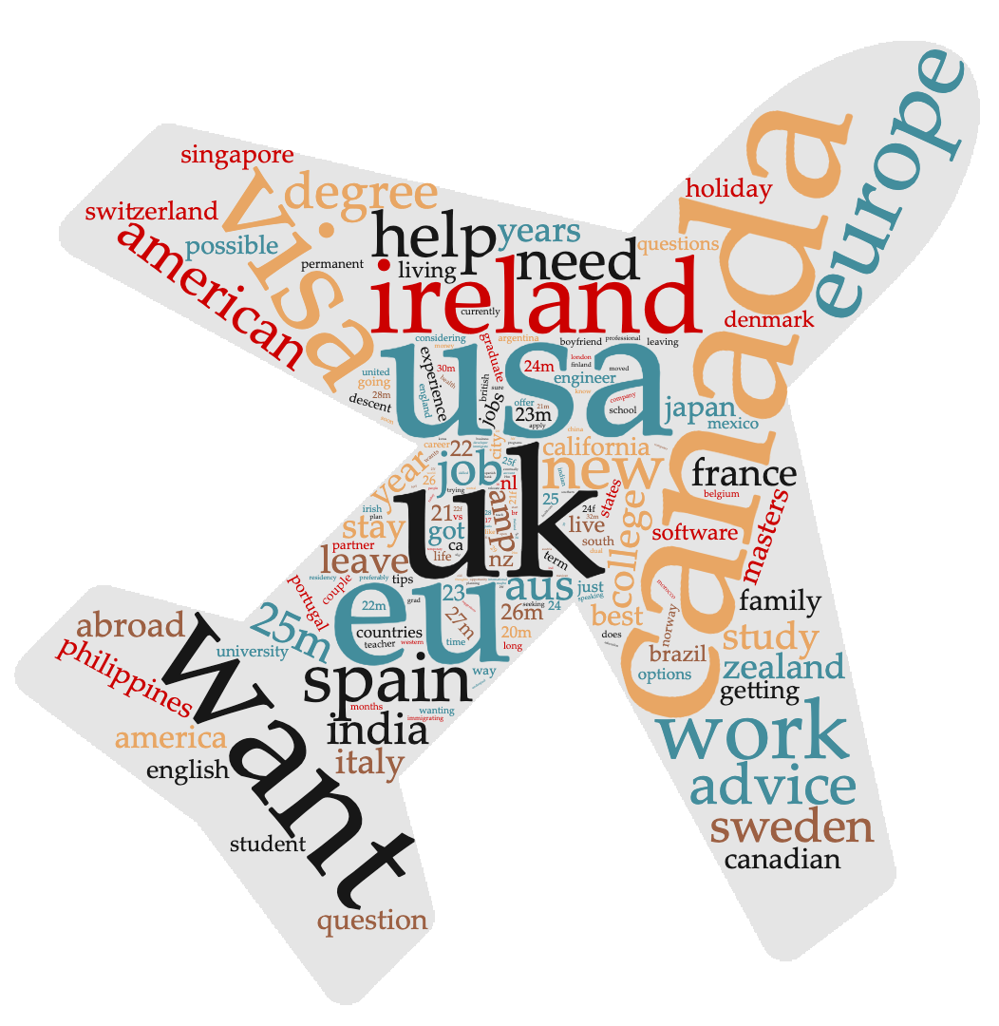
TOP 2 Countries
IWantOUT
Canada - 101
USA - 97

Slide 11
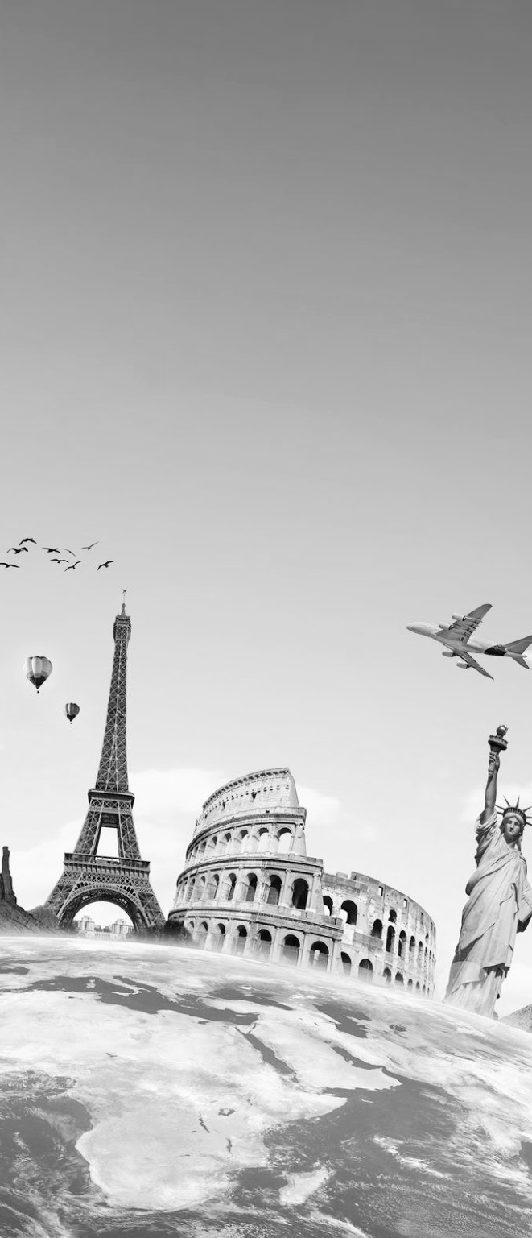
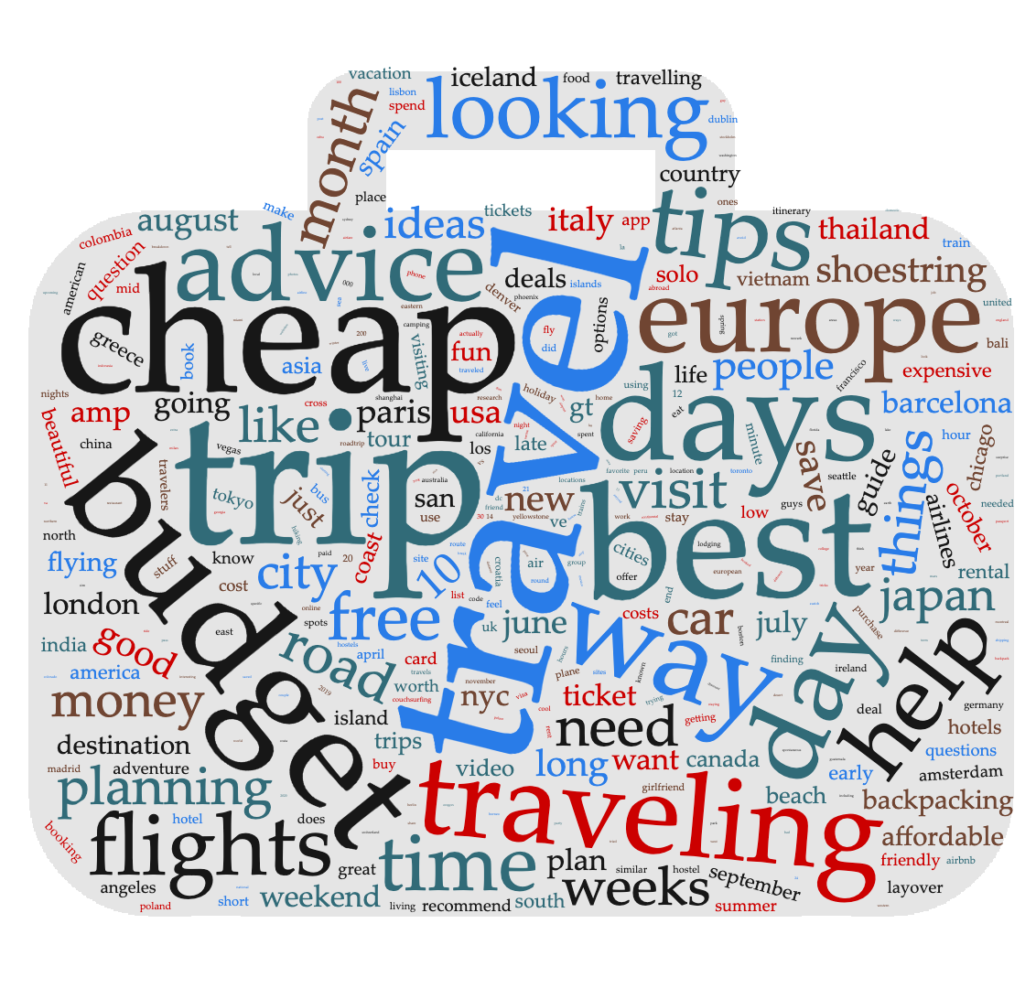
TOP 2 Countries
Shoestring
Europe - 35
Japan - 16

Slide 12
Classifications
Predictions based on post title
Removed titles with less than 3 words
Model managed to predict with an accuracy of 92%

Slide 13
Classifications
Guess which subreddit?
Help with Visa UK/Turkish Visa
Relocating to work at a hostel?
Study abroad in Ireland (23m from US)
Visiting Paris from San Francisco, initial thoughts...

Slide 14


Slide 15

AskScience vs ShittyAskScience!
r/AskScience:
Is Ceres a dwarf planet or an asteroid?
How does antibiotic efficiency differ between doses?
How do we know which two particles are entangled?
If prions are hard to destroy, why are prion-related diseases so rare?
What does the octane number mean for petrol?
r/ShittyAskScience:
If the Sun is too hot to land on, why don’t we just land on it at night?
If I have 50% chance of surviving a surgery, will doing it twice give me 100%?
Why don’t beached whales just roll back into the ocean?
If time heals all wounds, why doesn’t the Army stock up on time for its units?
Why is this cat blurry? Does it need glasses? (Weijie got this wrong without the image shown)

Slide 16
Human Test!
Shout out ‘Shitty’ or ‘Science’ for each question:
How does an air cooler work?
Are there any mammals with milk that isn’t white?
Why do modern helicopters still carry their legacy blades?
If I focused on my heart hard enough, could I control my heartbeat?
What kind of spider is this?
Would a twelve number system work?
How many standard helium filled balloons would it take to lift a grown person off the ground?
How does this car work if the spark plug has no wires to it?
What biological processes are involved in sun poisoning?
If air is such a good insulator, why do I still get cold outside?

Slide 17
ELI5: Findings
Technical science terms? Easy to identify (eg T-cell, lymphocyte) -> AskScience
Lots of stopwords? (eg and, the, why, how is, the, this) -> ShittyAskScience

